Slide 1
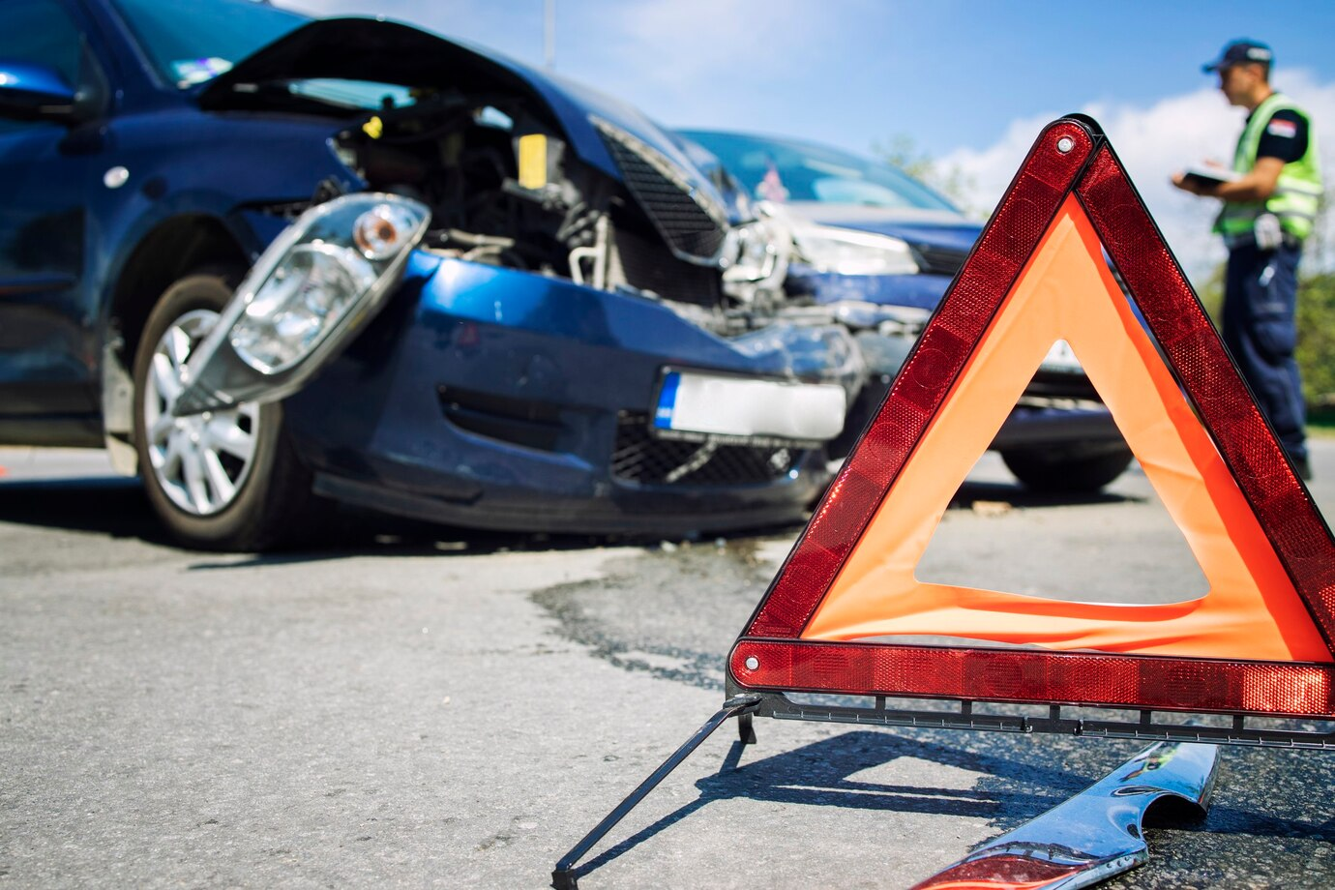
Project 4: Machine Learning Model for Car Crash Data
By: Kevin Carney, Paris Lee, Samantha Schutz, and Joy Weishan
October 3, 2024

Slide 2
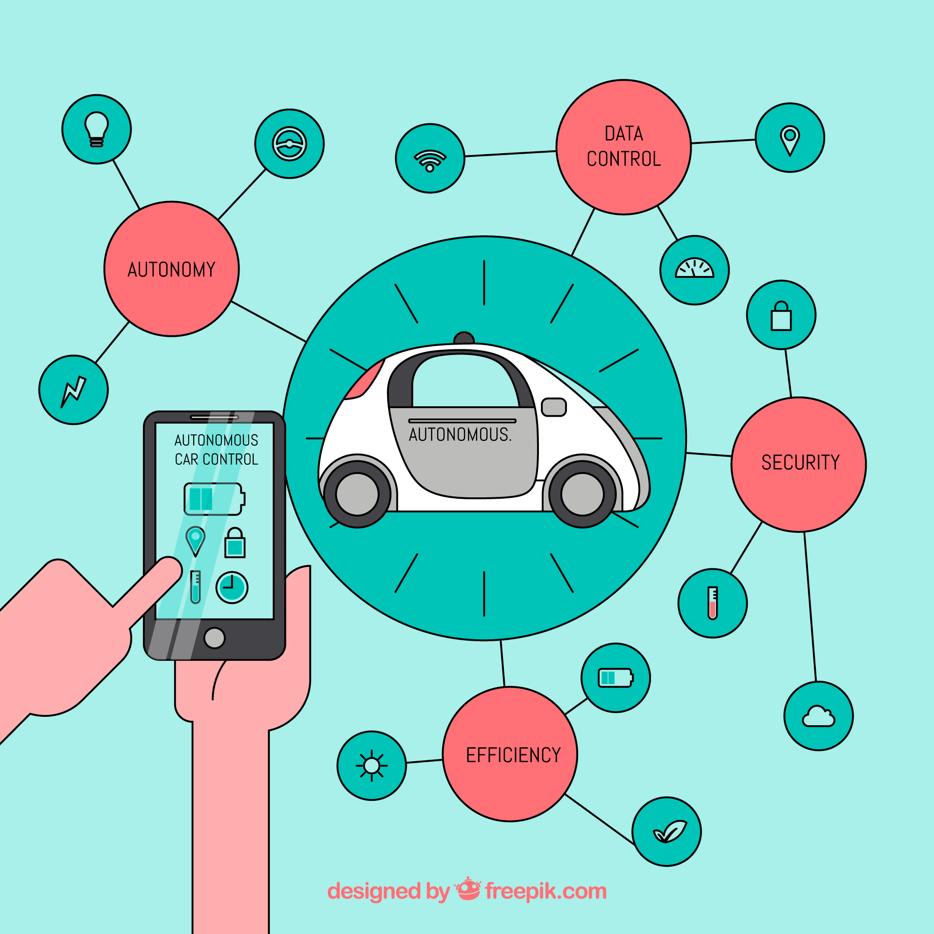
Purpose/Inspiration
Automation impacting every industry
Car manufacturing no exception
Is this a safe use of AI?
National Highway Traffic Safety Administration mandated reporting of vehicles with these automated systems
Automation in vehicles still heavily in development
Anyone using public roads possibly impacted
Many of our group work within healthcare
One of our group works for GM
Dataset has not been used and a good practice for real world application
Notes:
Joy

Slide 3

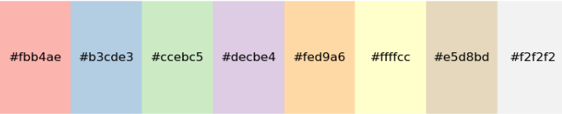
Design Concepts/Data Cleaning
More neutral web background used with greys, as it most appropriately fits the theme
Tableau visualizations had a wider array of colors, as visualization complexities created a need for more colors to be utilized
Multiple notebooks required for machine learning and 2 different Tableau dashboards
Many null values within dataset requiring dropped rows of data
Many conversions required to use data in a machine learning context
Notes:
Paris

Slide 4

Research Questions
Will certain weather conditions cause accidents resulting in whether someone gets injured or not? Is this predictable?
Will different vehicle conditions impact the result of an accident?
When do these accidents happen the most?
What are other environmental conditions that impact the outcome of an accident?
Notes:
paris

Slide 5

Live Demo

Slide 6
Limitations/Biases
Not all states had data
Majority of the data came from California (San Francisco), Arizona, and Texas
Machine learning portion: outcome heavily imbalanced toward “No Injuries” vs “Injuries”
In addition to the imbalance of the outcome, data had little variance in terms of conditions also making predictive modelling effectively nearly impossible
Many columns dropped for ease of data manipulation and visualization
Many ‘null’ values to deal with (filled with most sensible alternative value or dropped altogether)
Unknown if other vehicle involved and to what capacity
No standardized reporting methods across manufacturers
Possible for multiple reportings on same vehicle
Notes:
Sam

Slide 7
Conclusions/Future Work
Dataset proved to be difficult to make a truly meaningful predictive model from due to imbalances of outcome and varying conditions
6 million car crashes a year – there are not many related to automation at this point
Pull out more data and keep more columns to look further into the type of automated system and to see if different updates reduced number of accidents
Needs to be better reporting to determine cause of accident
Other vehicle involved?
Other unusual circumstances pulled out from “Narrative” column
Column added on if automation system being used appropriately
Comparing different versions of systems to determine if there were improvements made
Notes:
Kevin

Slide 8
Works Cited
Image on slide 1 & 2: designed by freepik.com
Image on slide 4: designed by vectorstock.com/20383246
“Park Assist Technology: A History ” by Yamuna Bindu Nov 11, 2021
https://blog.getmyparking.com/2021/11/11/park-assist-technology-a-history/
“Why August is 'the most dangerous driving month' of the year” Published Monday, July 30, 2018. CTV News.
Xpert Learning Assistant:
Xpert Learning Assistant - Used for debugging certain codes.
chatGPT:
chatGPT- Used for debugging certain codes.
“NHTSA Standing General Order on Crash Reporting Dataset Source” DOT of US government. June 2022.
“Using Machine Learning Models to Forecast Severity Level of Traffic Crashes by R Studio and ArcGIS” by Bara’ W. Al-Mistarehi, Ahmad H. Alomari, Rana Imam, Mohammad Mashaqba on April 19,2022.

